Slide 1


Introduction to Secure Login Systems
In today's digital world, secure login systems are essential for protecting sensitive data and accounts. These systems serve as the first line of defense against unauthorized access, ensuring that only legitimate users can gain entry to valuable online resources.

Slide 2
Components of a Secure Login System
Strong Authentication
Secure Session Management
Encryption and Data Protection
Robust authentication mechanisms, such as password policies, biometrics, and multi-factor authentication, are essential for verifying user identities and preventing unauthorized access.
Proper session handling, including session timeouts, session invalidation, and secure cookies, helps maintain the integrity of user sessions and mitigate session-based attacks.
Encryption of login credentials and other sensitive data during transmission and storage is crucial for safeguarding against eavesdropping and data breaches.

Slide 3

Authentication Factors
1
Knowledge Factors
2
Possession Factors
Passwords, PINs, and other information that the user knows and can provide to authenticate their identity.
Physical devices or tokens, such as security keys or mobile phones, that the user has in their possession to authenticate their identity.
3
Inherence Factors
Biometric characteristics, like fingerprints, iris scans, or facial recognition, that are unique to the user and can be used for authentication.

Slide 4
Password Security Best Practices
Complex Passwords
Password Management
Encourage users to create long, complex passwords that combine upper and lower case letters, numbers, and special characters.
Recommend the use of password managers to securely store and generate strong, unique passwords for each account.
Regular Updates
Password Policies
Enforce periodic password updates to reduce the risk of compromised credentials and limit their exposure.
Implement robust password policies that align with industry best practices and regulatory requirements.

Slide 5




Multi-Factor Authentication
Biometrics
One-Time Passwords
Hardware Tokens
Geolocation
Fingerprint, iris, or facial recognition to verify user identity.
Physical security keys that generate one-time codes.
Verifying the user's location to detect suspicious login attempts.
Codes sent to the user's registered mobile device or email.

Slide 6




Secure Session Management
Session Initiation
Secure the initial login process and generate a unique session ID.
Session Verification
Continuously validate the session to ensure it belongs to the legitimate user.
Session Termination
Properly terminate the session when the user logs out or after a set timeout period.

Slide 7

One-Way Function: Irreversible Transformation
1
Irreversible Process
2
Secure Storage
3
Protecting Data
Hash functions are designed to be one-way, meaning it's computationally infeasible to reverse the hashing process and obtain the original password.
Even if a hash value is exposed, attackers cannot easily derive the original password, ensuring the security of user credentials.
One-way hashing is a crucial security measure for safeguarding sensitive information like passwords, protecting users from potential breaches.

Slide 8
Salt: Defending Against Rainbow Tables
Randomized Input
Increased Complexity
Salting adds a unique, random value to each password before hashing, making each hash unique and resistant to pre-computed attacks like rainbow tables.
The combination of the password and the salt creates a more complex input, significantly increasing the time and resources required for brute-force attacks.
Mitigating Threats
Secure Storage
Salting is a crucial security measure that helps protect against common password cracking techniques, safeguarding user credentials.
The salt value is typically stored alongside the hash, ensuring that the hashing process can be replicated during password verification.

Slide 9




Pepper: An Additional Layer of Security
Secret Ingredient
Pepper is an additional secret value added to the password before hashing, providing an extra layer of security beyond just salting.
Increased Complexity
The combination of the password, salt, and pepper creates a highly complex input, making it exponentially more difficult for attackers to crack.
Resilience to Attacks
Pepper helps protect against advanced password cracking techniques, such as rainbow tables and GPU-accelerated brute-force attacks.

Slide 10



Slow Hashing: Deterring Brute-Force Attacks
Time-Consuming
Resource-Intensive
Increased Security
Slow hashing algorithms, such as bcrypt and Argon2, require significantly more time to compute each hash, deterring brute-force attacks.
Slow hashing algorithms consume more computational resources, making it impractical for attackers to perform large-scale, high-speed cracking attempts.
Slow hashing provides an additional layer of protection, ensuring that even if a database is compromised, cracking the hashes becomes an extremely time-consuming and costly endeavor.

Slide 11
Secure Storage: Protecting Hashed Passwords
Encryption
Hashed passwords should be stored in an encrypted database to prevent unauthorized access even if the system is breached.
Isolation
Password hashes should be isolated from other sensitive data, limiting the potential impact of a data breach.
Access Control
Strict access controls should be implemented, ensuring that only authorized personnel can access the password hashes.
Monitoring
Continuous monitoring and logging of access to the hashed password database can help detect and prevent unauthorized activities.

Slide 12
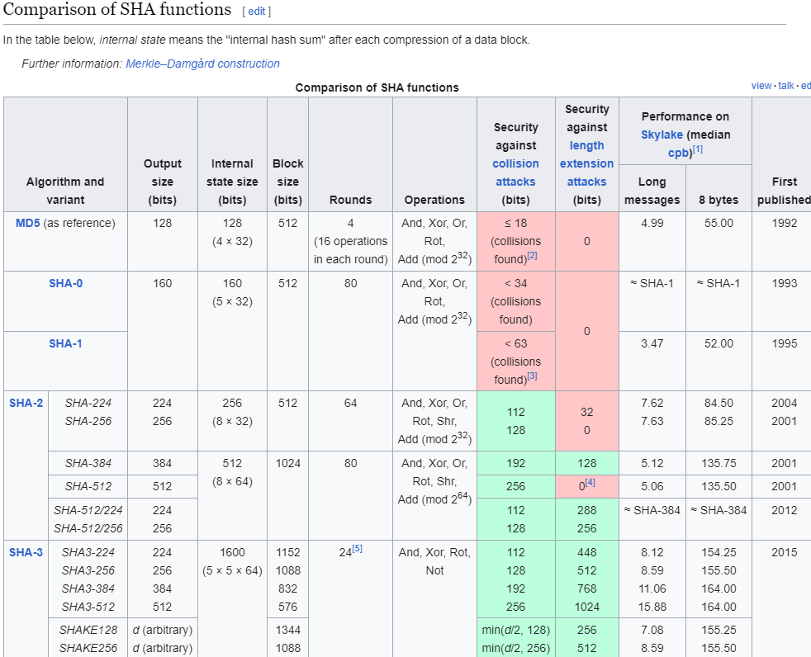

Slide 13
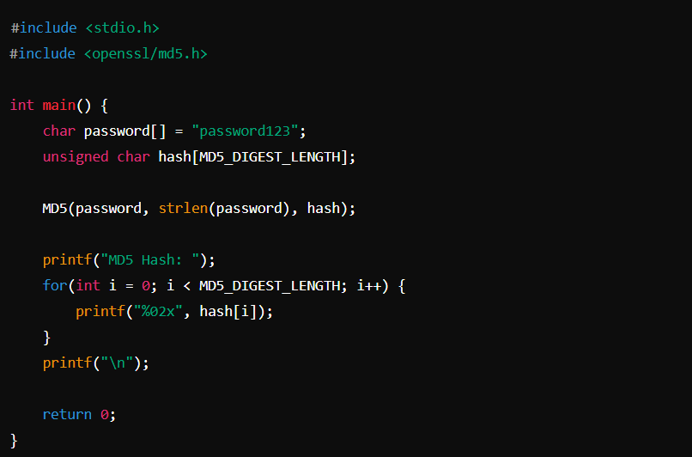
MD5 (Message Digest Algorithm 5):
Performance: MD5 is fast and efficient, making it suitable for applications where performance is a priority. However, its speed comes at the cost of security.
Strengths: MD5 is fast and straightforward to implement.
Weaknesses: Vulnerable to collision attacks and brute-force attacks due to its fast computation speed and cryptographic weaknesses.
Security: MD5 is considered weak and vulnerable to collision attacks, making it unsuitable for cryptographic purposes. It should not be used for security-sensitive applications.
Suitability: Not recommended for new applications due to its known vulnerabilities. It may still be used in legacy systems or non-security-critical applications where speed is prioritized over security.

Slide 14
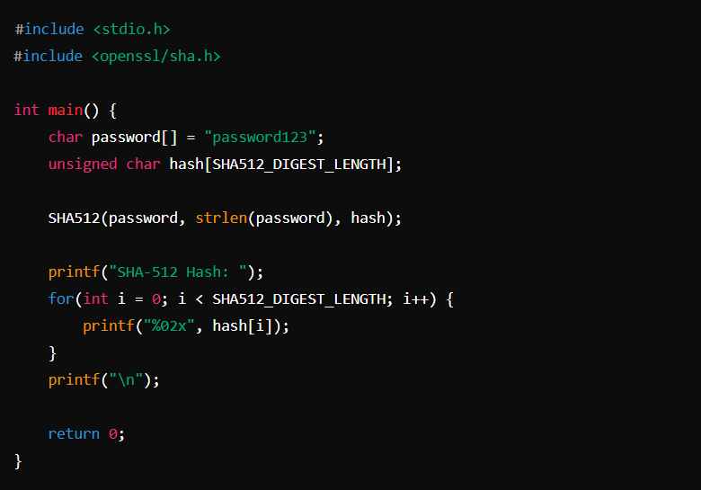
SHA-512 (Secure Hash Algorithm 512-bit):
Performance: SHA-512 is computationally intensive due to its larger digest size (512 bits), which may result in slower hashing compared to SHA-256. However, it offers a higher level of security.
Strengths: Provides a higher level of security with a larger hash size compared to SHA-256.
Weaknesses: While more secure than SHA-256, it may still be susceptible to brute-force attacks in certain scenarios.
Security: SHA-512 provides a high level of security with a larger digest size and resistance against various cryptographic attacks. It's suitable for applications requiring strong cryptographic security.
Suitability: Recommended for applications where security is paramount and performance considerations allow for slightly slower hashing operations. Suitable for password hashing, digital signatures, and data integrity verification.

Slide 15
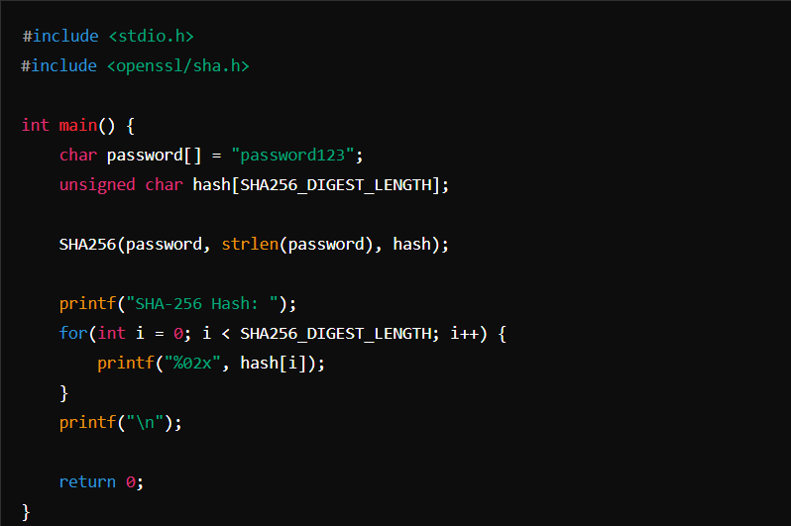
SHA-256 (Secure Hash Algorithm 256-bit):
Performance: SHA-256 is faster than SHA-512 due to its smaller digest size (256 bits), making it suitable for applications where performance is a priority.
Strengths: Provides a higher level of security than MD5 and SHA-1 with a 256-bit hash size.
Weaknesses: Vulnerable to brute-force attacks in certain scenarios, although significantly more secure than MD5 and SHA-1.
Security: While SHA-256 is secure and widely used, its smaller digest size may be susceptible to brute-force attacks in the future. However, it's still considered secure for many applications.
Suitability: Ideal for applications where a balance between security and performance is required. Commonly used for password hashing, digital signatures, and blockchain technologies.

Slide 16
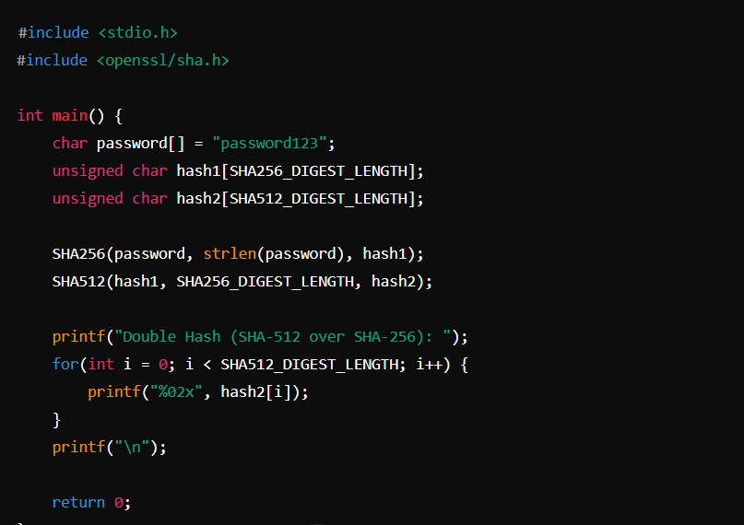
Double Hashing (SHA-512 over SHA-256):
Performance: Double hashing involves performing two hashing operations sequentially, resulting in slower performance compared to single hashing operations.
Security: Offers a higher level of security by combining the strengths of SHA-512 and SHA-256, making it resistant to various attacks.
Strengths: Combines the strengths of both SHA-256 and SHA-512 hashing algorithms, providing a more robust hash.
Weaknesses: While offering additional security, it may introduce complexity and performance overhead.
Suitability: Suitable for applications where an additional layer of security is required or where compatibility with both SHA-512 and SHA-256 is desired. However, the performance overhead should be considered for performance-sensitive applications.

Slide 17
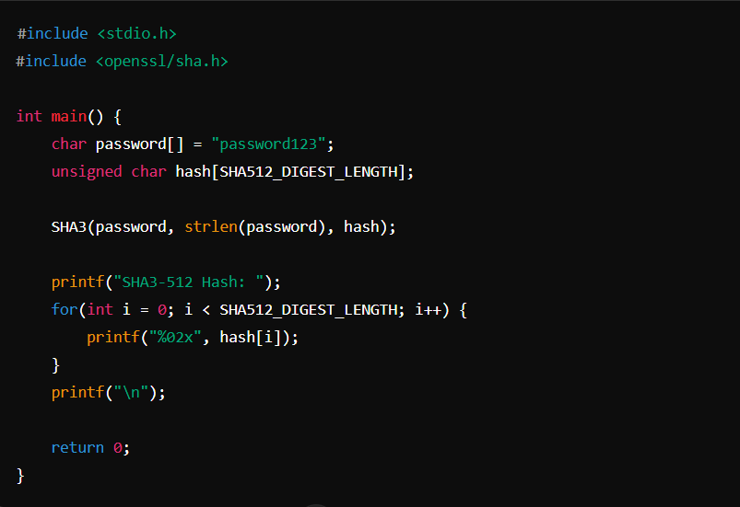
SHA3-512 (Secure Hash Algorithm 3, 512-bit):
Performance: Similar to SHA-512, SHA3-512 is computationally intensive due to its larger digest size (512 bits), resulting in slower hashing compared to SHA-256.
Strengths: Part of the SHA-3 family, offering a high level of security and resistance to various attacks.
Weaknesses: While highly secure, it may not provide significant advantages over other hashing algorithms for password hashing.
Security: SHA3-512 is part of the SHA-3 family, offering a high level of security and resistance to various attacks. It's suitable for applications requiring strong cryptographic security.
Suitability: Recommended for applications where compatibility with SHA-3 family algorithms is desired or where SHA-3 is mandated. Suitable for password hashing, digital signatures, and data integrity verification.

